Slide 1
Understanding and using the kit: Training of trainers for facilitators Module 5: Implementation and roll-out planning: Preparing to use the Adolescent Kit through your programmes
The Adolescent Development and Participation Section
Priya Marwah, Adolescents in Emergencies and Peacebuilding Specialist
Ellen Fransen, Programme Assistant
Juliet Young, Consultant

Slide 2
5.1 Using the Adolescent Kit for Expression and Innovation to strengthen your programme

Slide 3
Discussion: Sample scenario
How could “Keeping Children Happy” use the Adolescent Kit to strengthen their work with and for adolescents to support their development and use of competencies?
Keeping Children Happy (KCH) is an international NGO that organises recreation programmes for children in a refugee camp in Kenya.
They have ten Child Centres where around 500 children come regularly. Each centre is managed by two facilitators. Centres are open from 1PM – 5PM (because school hours are from 9AM-12PM).
Children who come to the centres are between the ages of 6 and 15 years old. The majority are boys. When they come to the centres they can play freely in a safe space. Some of the adolescent boys have organized themselves into small groups to play football, and the girls like to play jump rope.
Notes:
Notes for trainer:
Alternative approach: This activity provides an opportunity for a broad and general discussion of possibilities for how the Adolescent Kit can be used to strengthen a programme. If specific plans have already been established for how the Adolescent Kit will be used in your programme context, as an alternative to this step, facilitate a discussion of how the Adolescent Kit can specifically be used to strengthen areas or your programme in keeping with those plans.
Recommendation: This step uses the same scenario and guidance as the ‘Integrating the Adolescent Kit practice scenario tool.’ This activity may be more effective if participants do not have that document available for reference, so that they think of their own ideas rather than follow those outlined on that tool.
Ask: How could KCH use the Adolescent Kit to support adolescents who are already participating in their Child Centre programme?
Possible answers:
Consult with older children and adolescents about the kind of activities they would like to participate in, or skills and knowledge they would like to gain during their time at the Child Centres
Try to find out where older adolescents (15-18 years) and adolescent girls are in the camp, and why they don’t come to the Child Centres; then use the guidance in the Adolescent Kit to find ways to reach out to them
Organise children and adolescents into groups or circles using the Adolescent Circles approach
Introduce more structured sessions for groups of girls and boys at set times during the Child Centres’ opening hours (for example, using the session steps outlined in the Facilitators’ Guidance)
Introduce a mix of activities including games, projects, or arts using the Activity Guides in the Adolescent Kit
Consider moving some of the activities physically outside the Child Centres
Help adolescents to develop competencies – skills, knowledge and attitudes – that can help them to improve their psychosocial wellbeing, learning and connection with their communities, through their activities together at the Child Centres
Ref: Programme Coordinators’ Guidance, Decide how to use the kit, Integrating the Adolescent Kit: Practice Scenario Tool

Slide 4
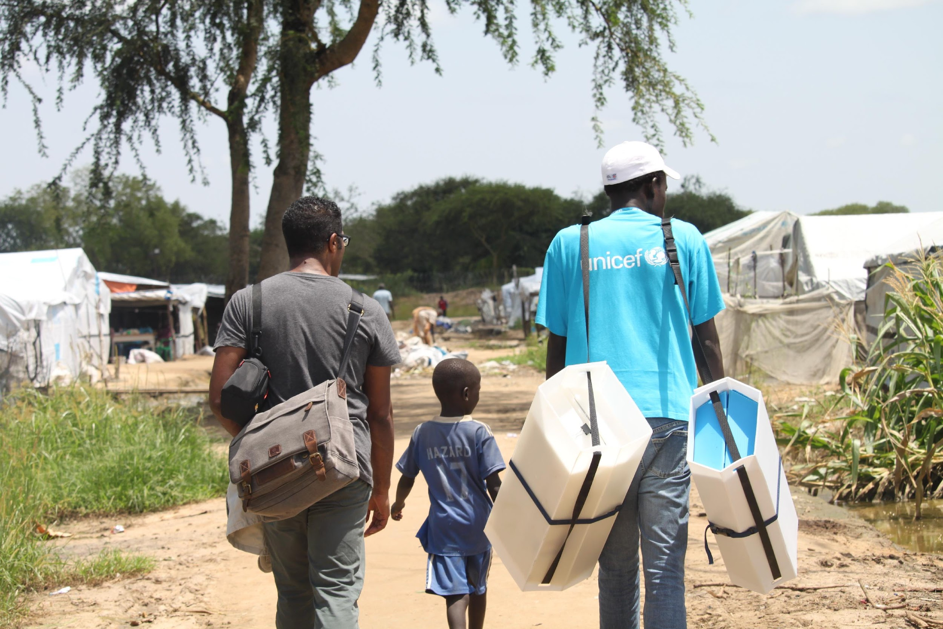
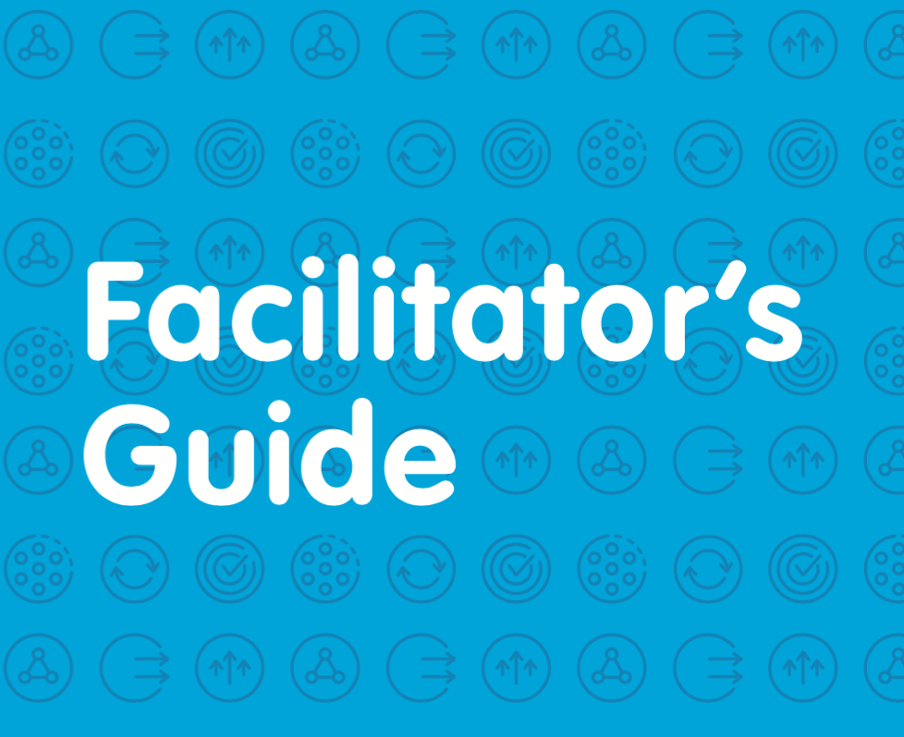
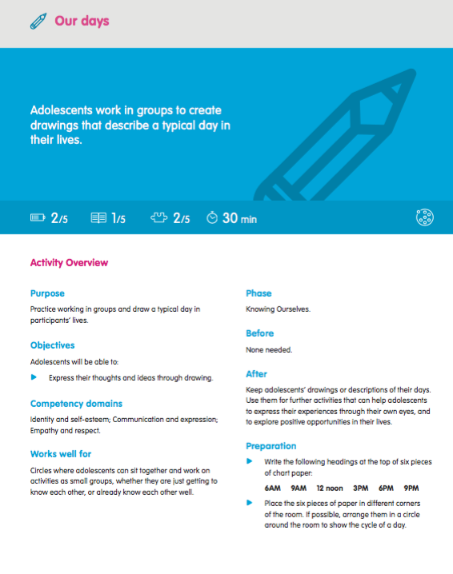
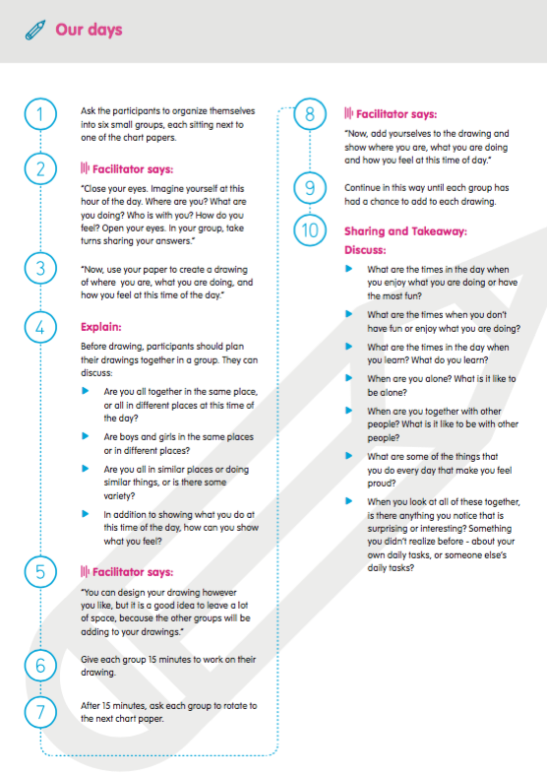
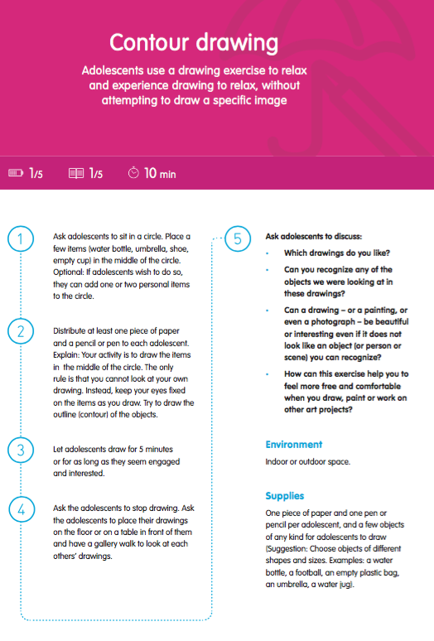
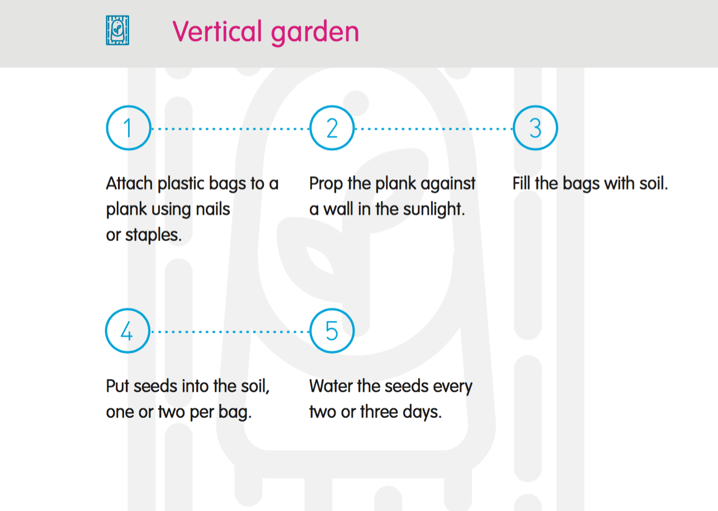
Notes:
Notes for trainer:
Explain: In this final module, workshop participants will draft plans for how they will use the Adolescent Kit as a resource to strengthen their programmes.
Add additional information or explanation of how they will proceed with developing and finalizing their plans. (For example, in the pilot tests of this training module, workshop participants working for UNICEF’s partner organizations developed draft plans, which they later shared with the programme managers of their organizations. Those were subsequently revised and incorporated into their partnership agreements with UNICEF.)
This slide provides a visual reminder of all of the resources in the kit, including supplies and guidance that are available in print, as well as electronic guidance and tools included on the website.

Slide 5
5.2 Implementation and roll-out: Focusing on competency outcomes for adolescents

Slide 6
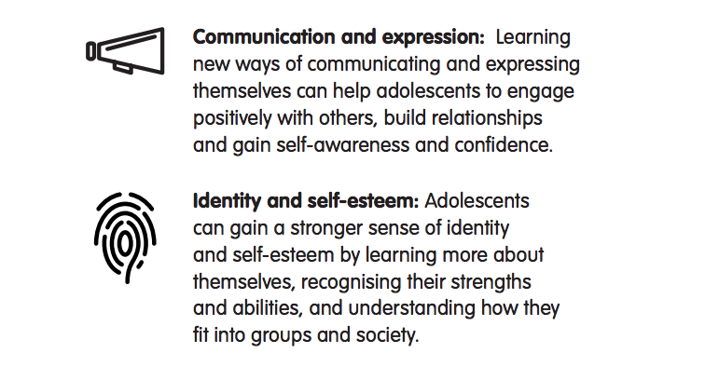
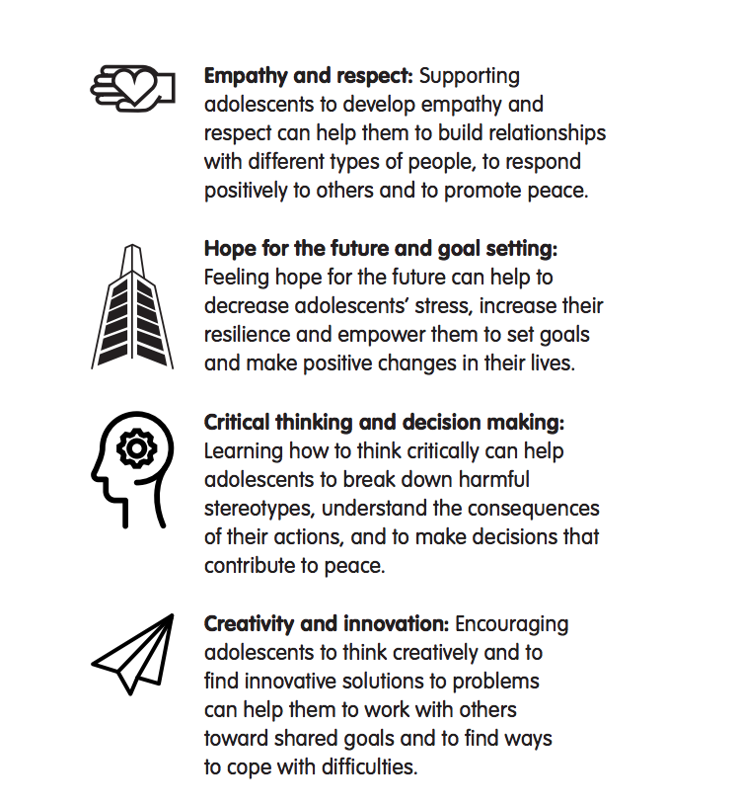
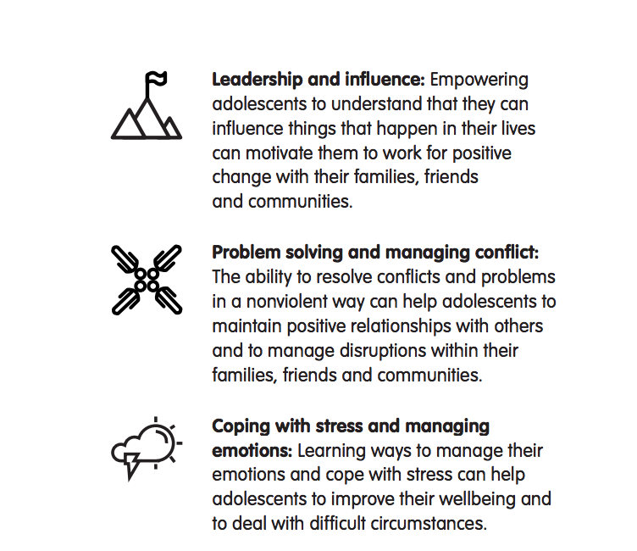
Discussion/
planning
Which competencies will adolescents in our programme most benefit from developing and using?
The Ten Key Competencies
Notes:
Notes for trainer:
This session builds directly on what workshop participants learned, and their analysis of the needs of the adolescents with whom they worked (Session 1.3). One recommendation is to have participants’ notes and presentations from that session ready for use during this session.
Alternative strategy: If workshop participants have yet not carried out Session 1.3, integrate steps from that session before beginning this one.
Review the Ten Key Competencies to refresh workshop participants’ understanding of each.
Ask: Which domains are of most potential value for adolescents in our programme context? Encourage participants to consider their notes from Session 1.3. They may want to focus most on competencies that:
Adolescents are struggling to develop or use;
Enable adolescents to overcome the barriers they face or take advantage of opportunities available to them;
Enable adolescents to make positive changes in their own lives; and/or
Enable adolescents to make positive changes in their communities.
Optional strategy: Take an inventory of which competencies are already the explicit focus of the programme or intervention in which workshop participants will be using the Adolescent Kit, which are being addressed by the programme or intervention (even if they are not specifically mentioned). Consider whether to strengthen the programmes’ focus on the competencies already being addressed, or to introduce a focus on new competencies into programme goals.
In plenary, agree to one or more of the competencies that everyone in the group believes are most relevant and useful for adolescents. In some cases participants may want to include all domains. While this is possible, to focus the program, it is helpful to select 1 – 3 domains.
Ref: Foundation Guidance: The Ten Key Competencies

Slide 7
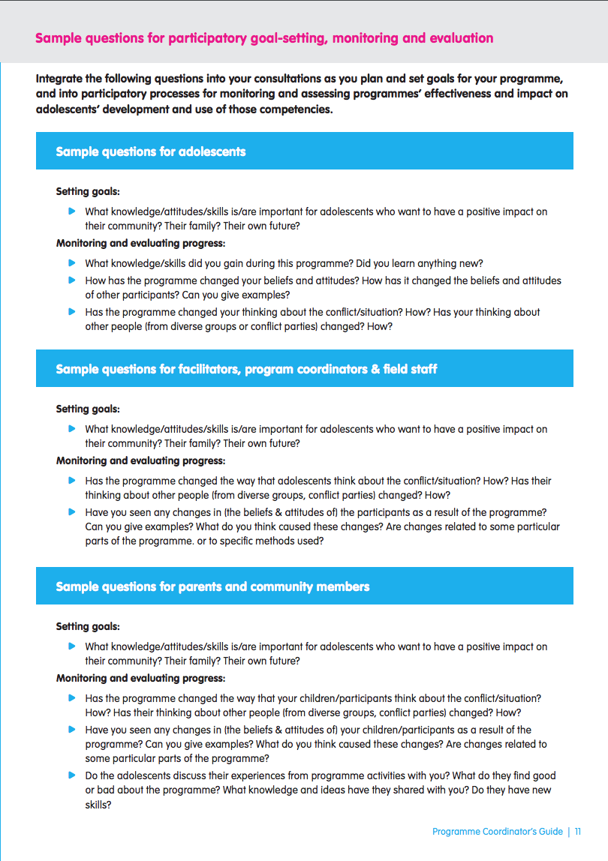
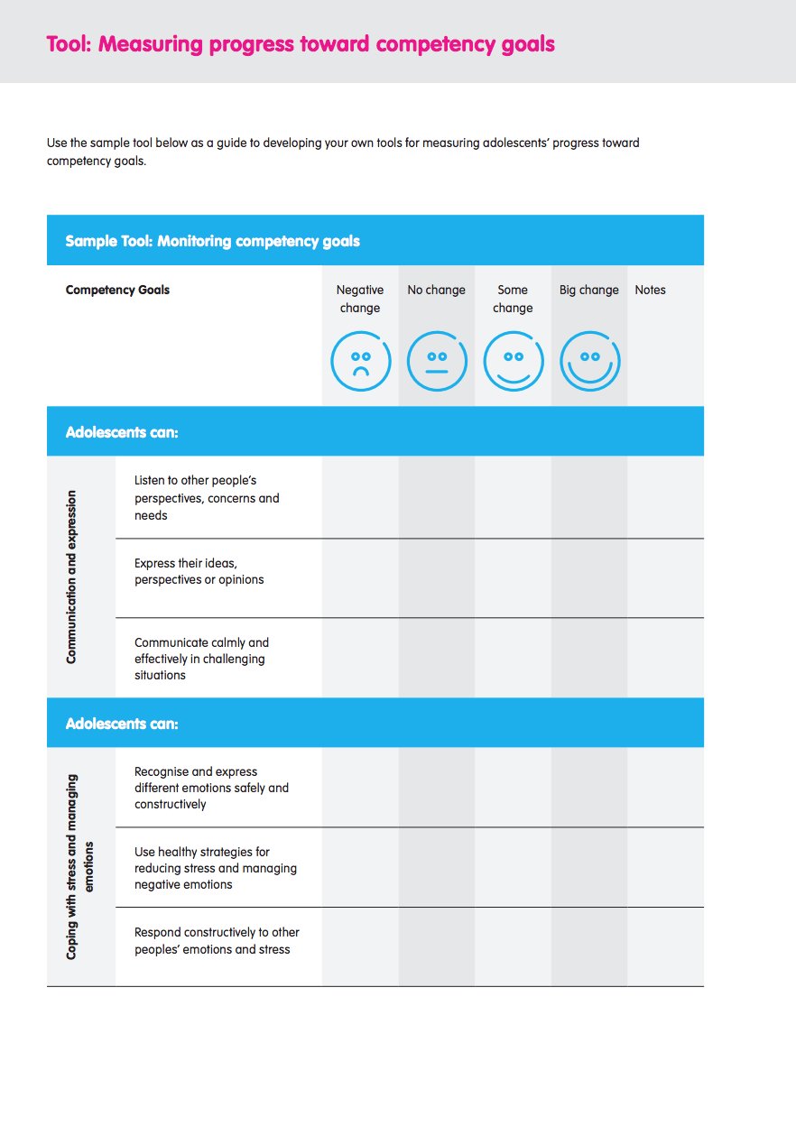
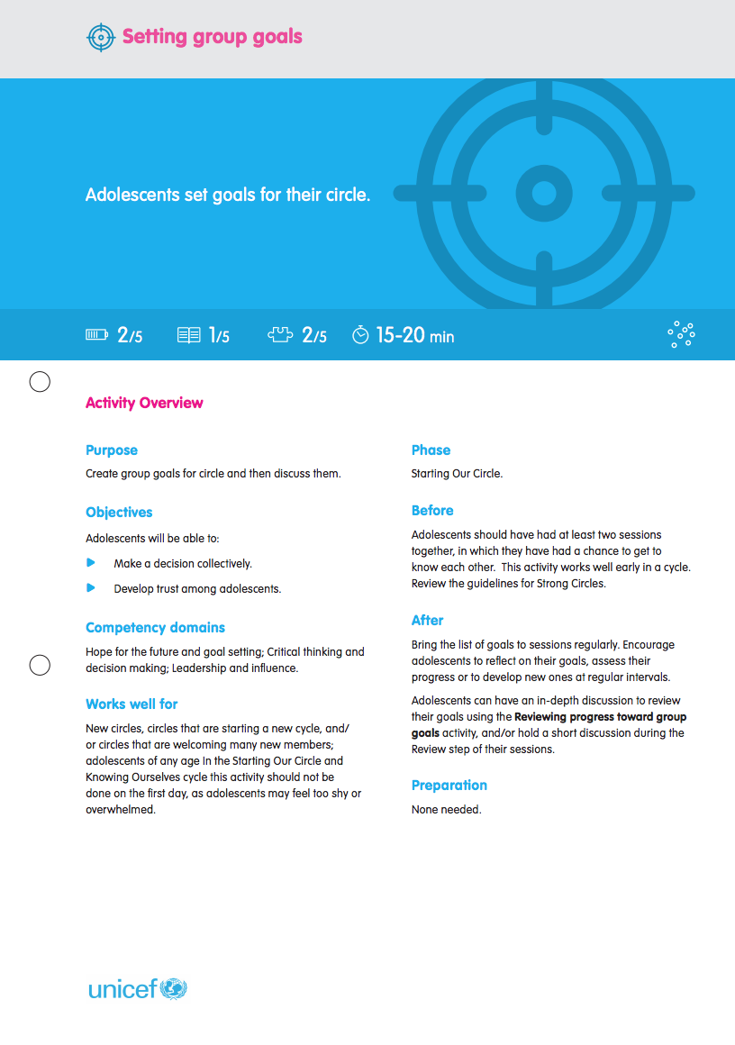
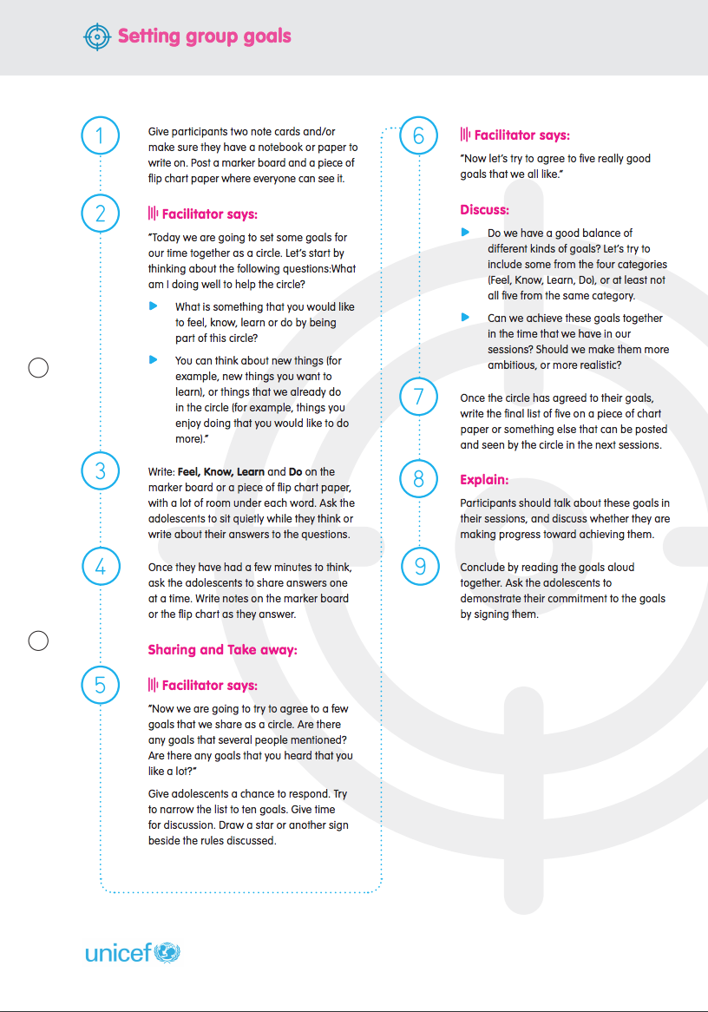
Setting goals for competencies:
Strategies and tools
Consult and collaborate with stakeholders
Consult and collaborate with programme staff, community members, and adolescents
Create space for adolescents to formulate their own goals in their Adolescent Circles
Refine and clarify goals
Review examples of possible goals
Map competency outcomes, including knowledge, attitudes and skills
Formalize goals
Set indicators
Notes:
Notes for trainer:
Explain: Now that workshop participants have some general plans in place for the competencies that their programme should focus on, they can use additional strategies to strengthen their plans. They can consult and collaborate with other stakeholders in their programme context, and refine their plans to include more specific goals and indicators for the competencies adolescents will develop and use as a result of their participation in the programme.
The Programme Coordinators’ Guide, Decide how to use the Adolescent Kit, Competency monitoring and evaluation tools support both processes. Ask participants to review these tools.
Remind workshop participants that they should support facilitators in working with adolescents to set their own goals for what they want to learn, do and achieve through their participation in programmes (as discussed in Module 4, Session 4.4). Through that process, adolescents may suggest different competencies that they want to focus on, rather than the ones that these workshop participants chose to prioritize. In that case, programme activities and plans should be adapted to address adolescents’ priorities.
Provide workshop participants with time to formulate plans for how they will use the guidance and tools as they move forward with the implementation and roll-out planning process. They can also discuss this in Session 5.3 Developing implementation and roll-out plans, which follows.
Ref: Programme Coordinators’ Guide, Decide how to use the Adolescent Kit, Competency monitoring and evaluation tools
Ref: Activity Guide: Setting group goals
Ref: Facilitator tools: Mapping competency goals

Slide 8
5.3 Developing implementation and roll-out plans

Slide 9
Developing (proposed) Action Plans to use the Adolescent Kit for Expression and Innovation in your programme
In this session, together we will:
Draft a proposed Action Plan that we will share between UNICEF and participating partner organizations
Focus on a specific part of our programme(s) in which we will use the Adolescent Kit
Focus on how we will use the guidance and activities to make your programme stronger and better for adolescents.
Explore whether we will procure Supply Kits to help make activities for adolescents more effective and fun. (Each Supply Kit can be used for up to 50 adolescents, organized into two circles of 25 adolescents each).
Notes:
Notes for trainer:
This module is designed for UNICEF its partner organizations to collaborate in developing plans to select, adapt and use resources from the Adolescent Kit for Expression and Innovation to strengthen their programmes. The idea is that workshop participants from UNICEF and its partner organizations will develop draft plans in this session, then finalize and confirm them through their official planning processes (such as in Partnership Commitment Agreement amendments).
Adapt this slide and your instructions to the specific planning process for your programmes and workshop participants’ preparation to use the Adolescent Kit.
Organize workshop participants into small planning groups according to whatever process will be most helpful and practical. For example, participants may wish to sit with colleagues from the same organization, or who work in the same geographic area, so they can collaborate and coordinate their plans.

Slide 10
Draft Plans: How will we use the Adolescent Kit for Expression and Innovation in our programme?
1. Organization name and your name
2. Programme through which you plan to use the Adolescent Kit
3. How many adolescents would you hope to reach using the Adolescent Kit? Which adolescents? (M/F, ages, other characteristics)
4. Where does your programme implement activities? (Location/s)
Remember:
Focus specifically on the programme in which you will use the Adolescent Kit.
The number of Supply Kits will depend on the number of adolescent participants (1 kit : 50 adolescents)
Notes:
Notes for trainer:
Recommendation: Adapt this slide and your instructions to the specific planning process for your programmes and workshop participants’ preparation to use the Adolescent Kit.
Develop a different planning template if you feel that is appropriate.
To provide participants with an overview of the planning template, read through the planning questions on this slide and the two that follow. Once workshop participants understand the template and planning questions, return to this slide, and give them time to begin their work together. Move forward through the subsequent slides as workshop participants complete each step of the draft planning process.
Ref: Programme Coordinators Guide, Decide how to use the adolescent kit, Planning template for implementing organizations Tool

Slide 11
Draft Plans: How will you use the Adolescent Kit for Expression and Innovation in your programme?
5. What are the activities and goals of the programme in which you would use the Adolescent Kit for Expression and Innovation (including guidance, tools and supplies)?
6. Which guidance materials and tools will you use from the kit? How will these complement or be integrated with the other curricula, guides, manuals or other resources you are using within that programme?
7. How will using the guidance materials and activities strengthen your programmes? What will change or improve for adolescents?

Slide 12
Draft Plans: How will you use the Adolescent Kit for Expression and Innovation in your programme
8. What competencies for adolescents will you focus on in your programme? Explain your choice.
9. Which activity cycles will facilitators use when planning activities for adolescents? Explain your choice.
10. Training Plan Outline How many facilitators will you train? Where and when will you conduct trainings? Describe your training approach – e.g. ToT, integrated into facilitator training, in-service trainings
Notes:
Notes for trainer:
Note: Adapt this slide and your instructions to the specific planning process for your programmes and workshop participants’ preparation to use the Adolescent Kit. Develop a different planning template if you feel that is appropriate.
When participants have finished drafting their plans, give them time to present them and share feedback.

Slide 13
5.3 Procuring and preparing to use supplies

Slide 14
About the Supply Kit
The Supply Kit is a set of materials, equipment and supplies that can be used to support activities with adolescents. Each Supply Kit is designed to meet the needs of 50 adolescents and four facilitators.
Notes:
Notes for trainer:
Note: Use this slide for workshop participants who will be supporting distribution and use of the Supply Kits through their programmes.

Slide 15
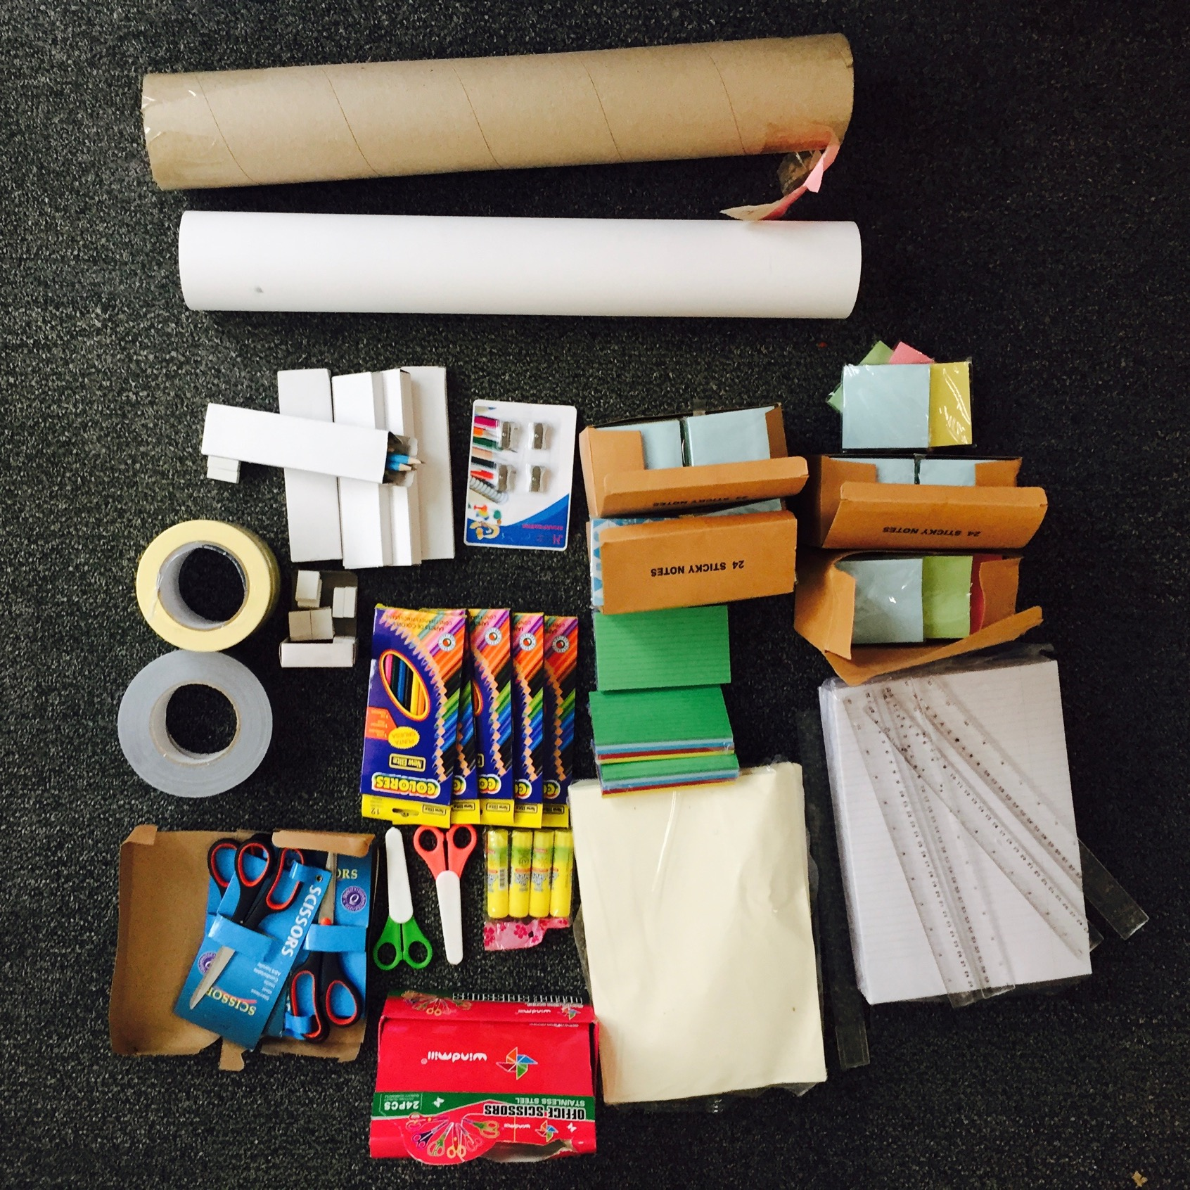
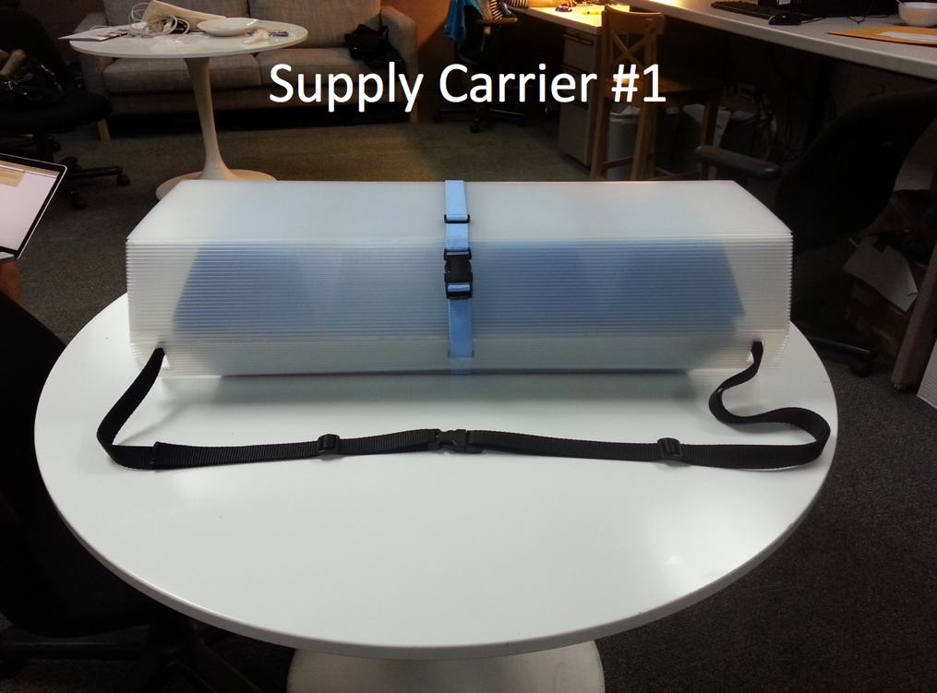
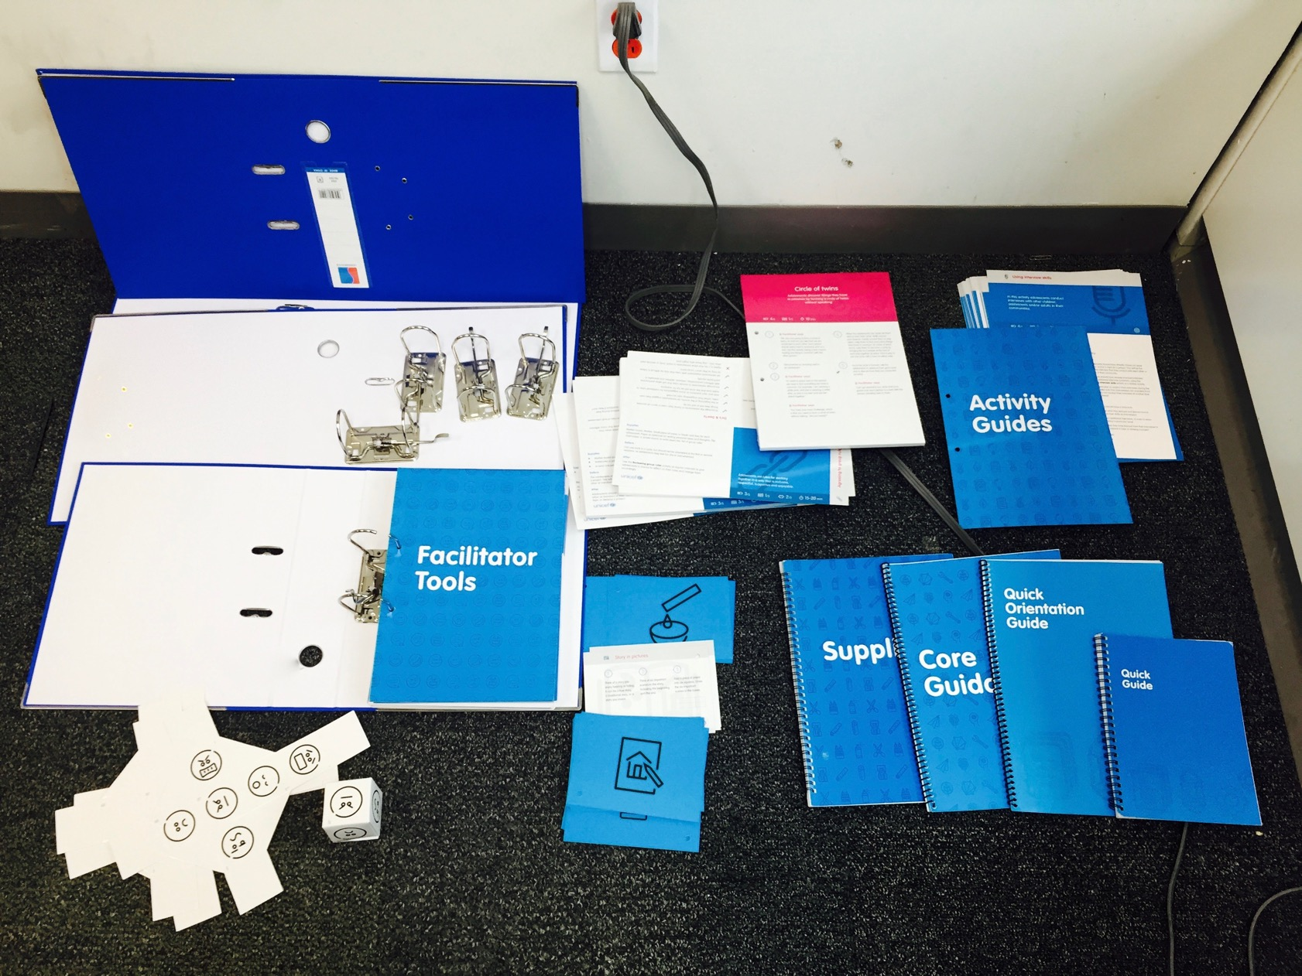
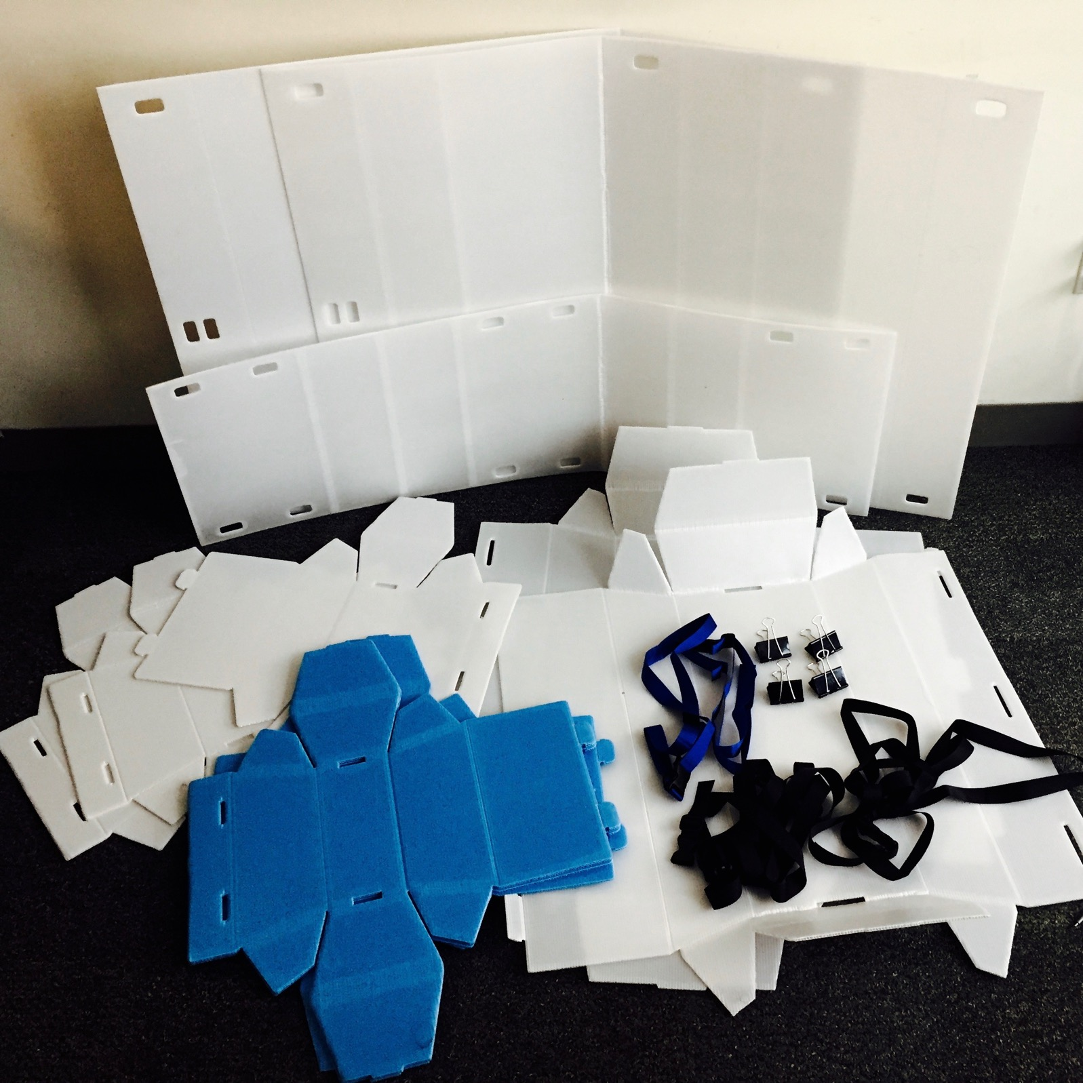
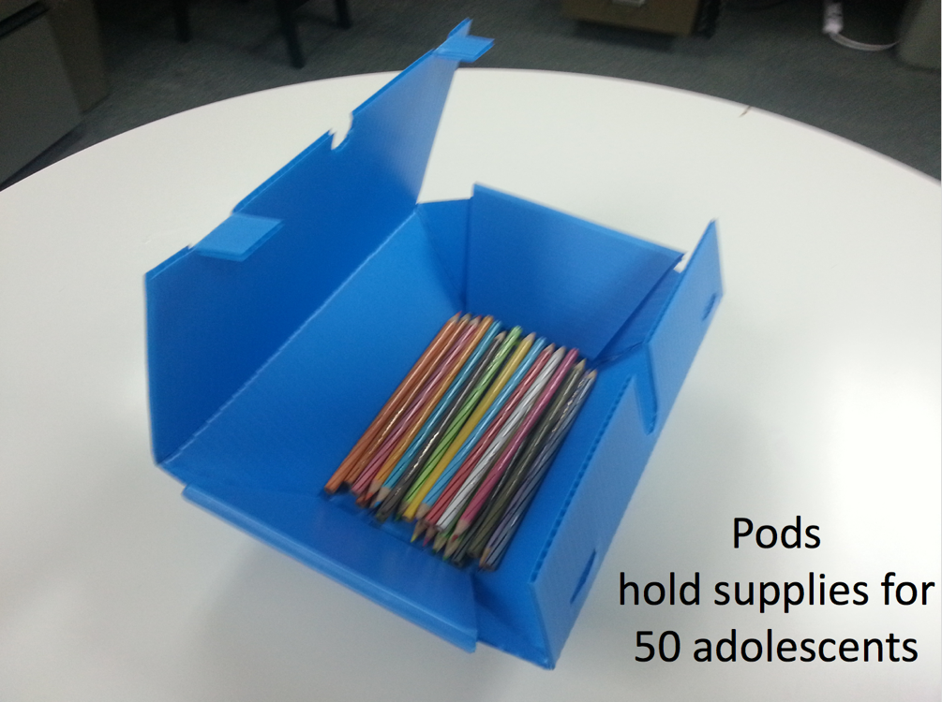
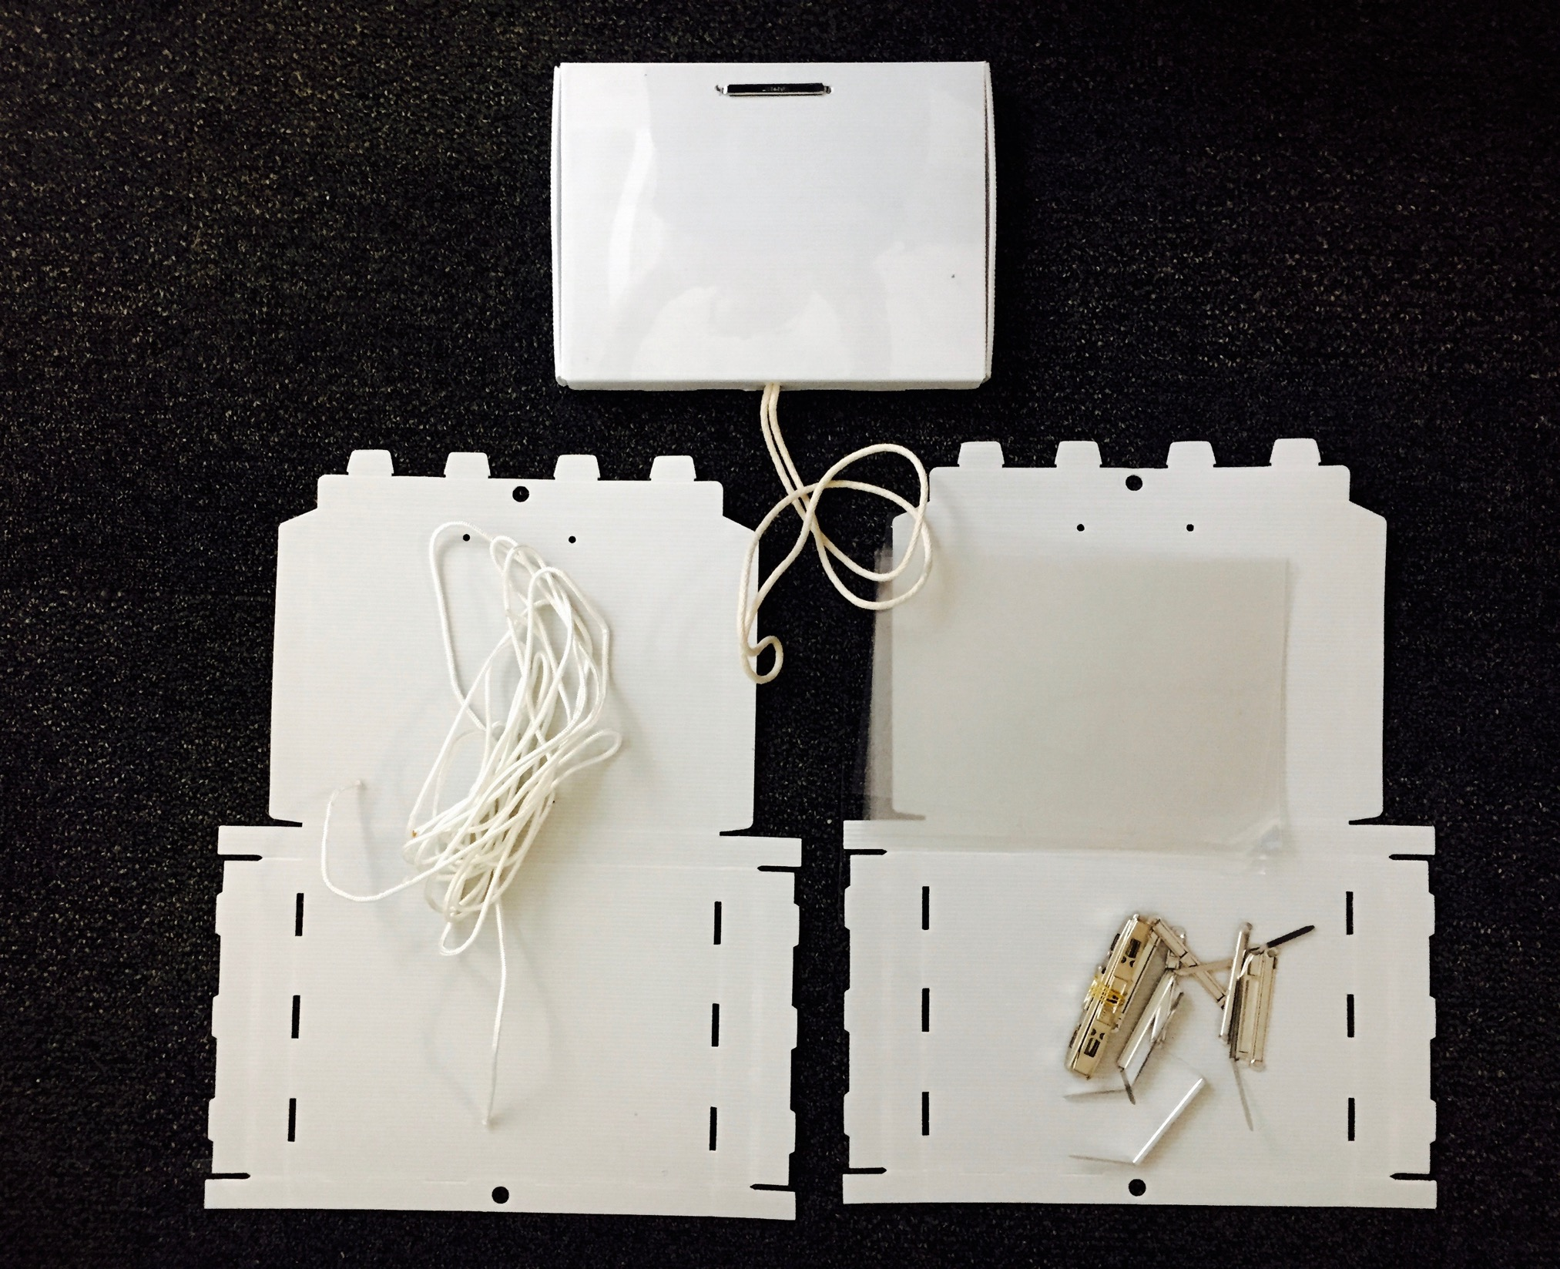
What is in the Supply Kit, and how do you use the different components?
Notes:
Notes for trainer:
If possible, the best way to present the resources in the Supply Kit is to demonstrate using an actual a Supply Kit, showing the contents to participants, including how to assemble the different components. If this is not possible, use the Supply Guide and the webinars, photos and videos at www.adolescentkit.org to show participants the contents of the Kit, and how to assemble and use the components.
Ref: Webinars: https://www.adolescentkit.org/kit/intro-webinar.html
Ref: Supply Guide, with a focus on the supply list
Ref: Video demonstrations for assembling the supply carriers, pods and tablets at: https://www.adolescentkit.org/kit/supply-guide.html

Slide 16
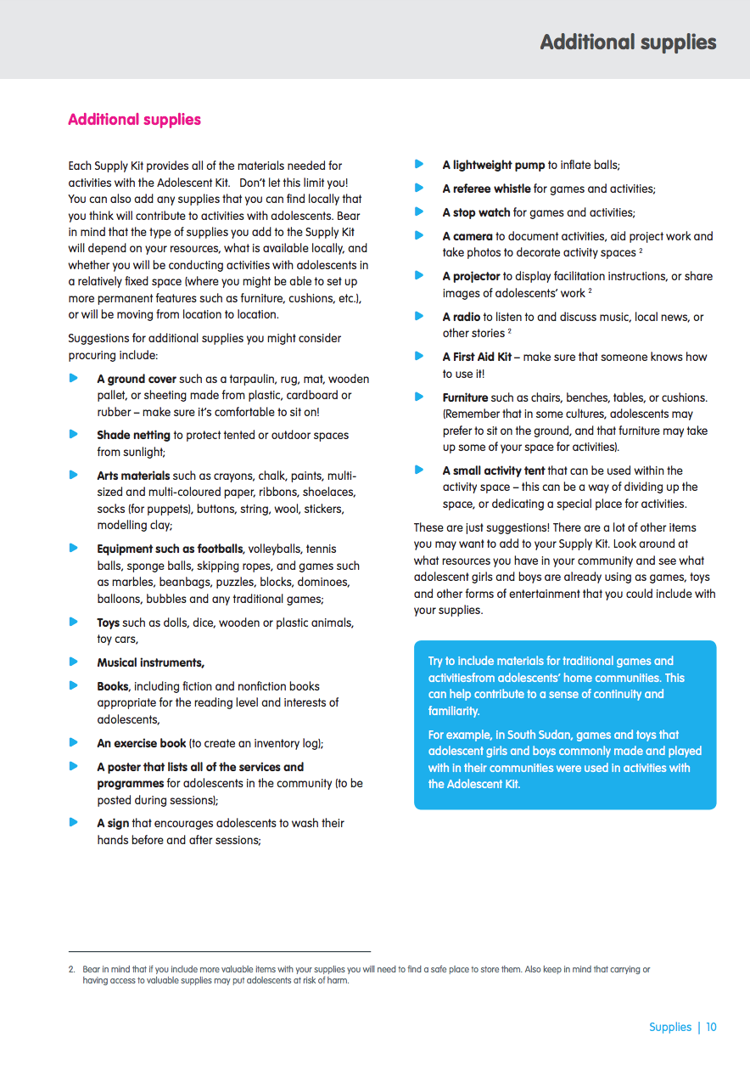
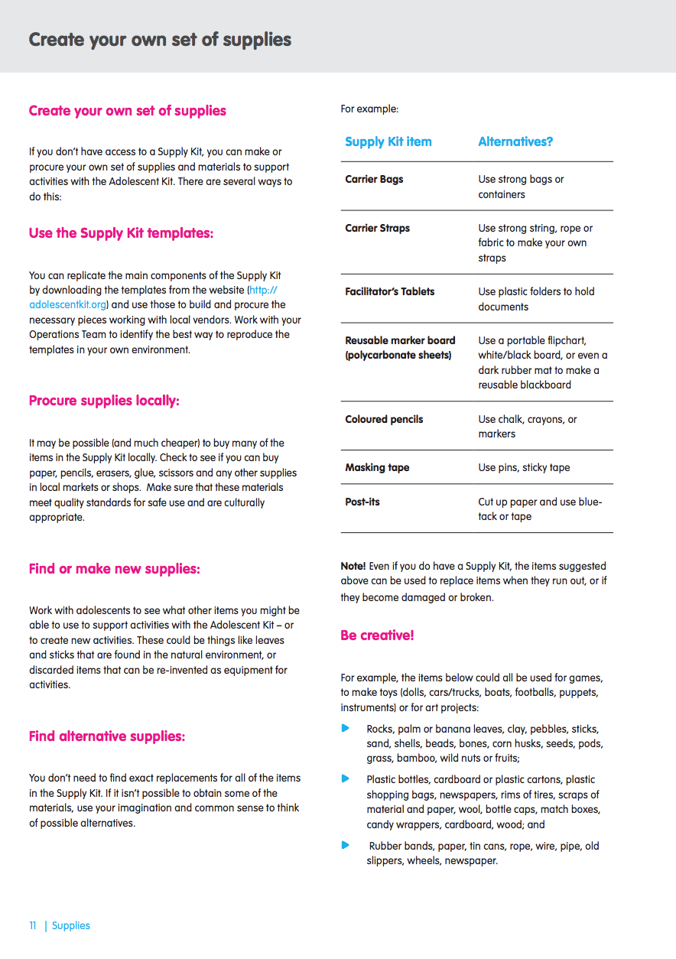
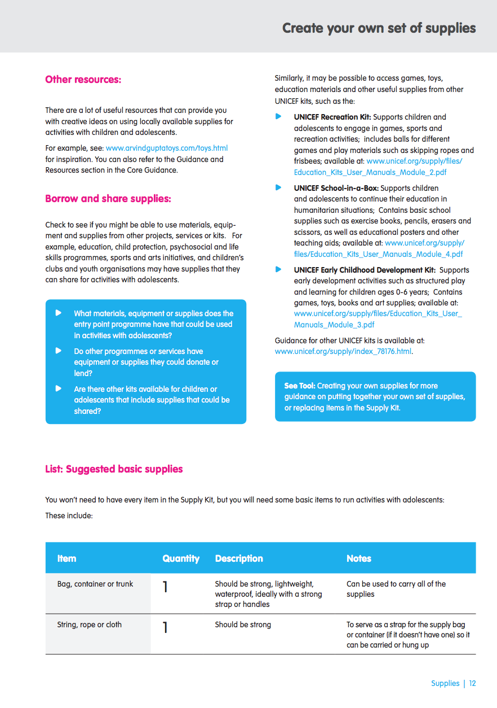
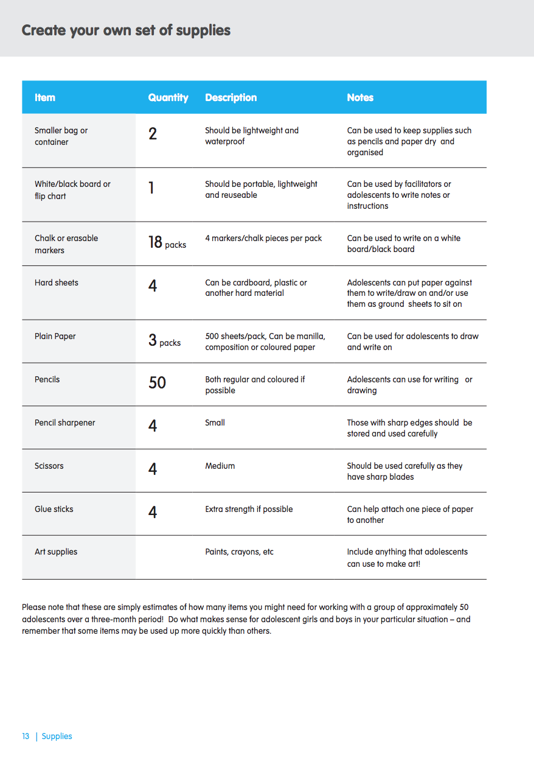
Discussion/
Planning
Procuring supplies locally
In addition to, or instead of the resources in the Supply Kit, what supplies will we procure locally?
Notes:
Notes for trainer:
Organize participants into small planning groups.
Participants should review the Supply Guide sections: Additional supplies, Create your own supplies and list of suggested supplies, and then develop their own supply lists.
Suggest that participants adapt the supply list based on specific plans for their programmes, taking into consideration what supplies are available locally, programme budgets, whether they will be using the Supply Kit, and any other considerations.
Ask participants to present their proposed lists and share feedback. Use presentations as an opportunity to ensure that their proposed lists are aligned to resources available.
Ref: Supply Guide, with a focus on the supply list

Slide 17
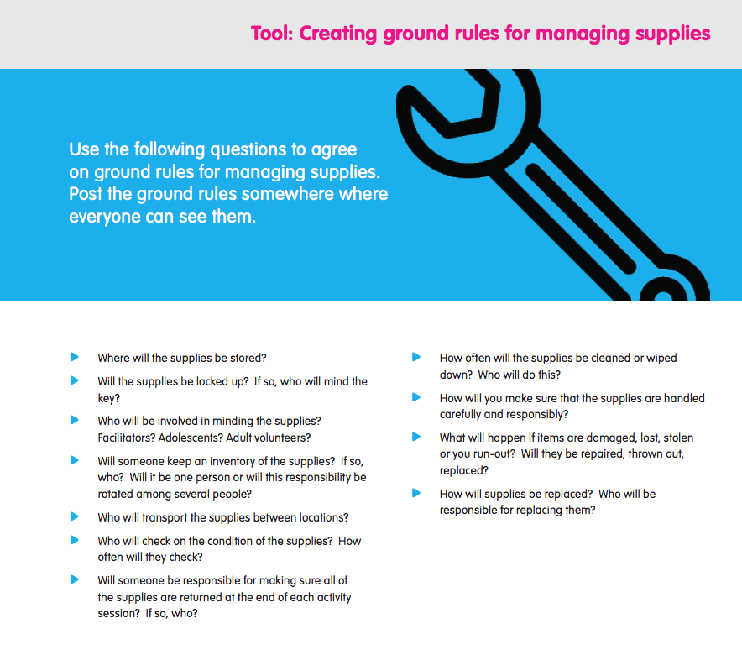
Developing plans to manage and use supplies
Notes:
Notes for trainer:
Use or adapt the following questions from the Creating ground rules for managing supplies Tool to develop plans to managing supplies. Integrate these plans into the overall programme.
Discuss and agree to plans using the following checklist:
Where will the supplies be stored?
Will the supplies be locked up? If so, who will mind the key?
Who will be involved in minding the supplies? Facilitators? Adolescents? Adult volunteers?
Will someone keep an inventory of the supplies? If so, who? Will it be one person or will this responsibility be rotated among several people?
Who will transport the supplies between locations?
Who will check on the condition of the supplies? How often will they check?
Will someone be responsible for making sure all of the supplies are returned at the end of each activity session? If so, who?
How often will the supplies be cleaned or wiped down? Who will do this?
How will you make sure that the supplies are handled carefully and responsibly?
What will happen if items are damaged, lost, stolen, or you run-out? Will they be repaired, thrown out, replaced?
How will supplies be replaced? Who will be responsible for replacing them?
Ref: Supply Guide, with a focus on Creating ground rules for managing supplies Tool

Slide 18
Action planning
Developing plans to manage and use supplies
Do our plans reflect all of these good practices?
Use your supplies!
Take good care of your supplies
Store your supplies somewhere safe
Keep an inventory
Involve adolescents!
Get the most out of your supplies
Be prepared
Replace supplies locally
Notes:
Notes for trainer:
Ask participants to review their plans, and consider whether their plans reflect all of these principles. For more detail on how to put these principles into action, participants can consult the Supply Guide, Maintaining supplies guidance.
Provide time for participants to review Supply Guide, Make and use an inventory book, and Programme Coordinators’ Guide, Manage supplies (guidance and all tools)
Ref: Supply Guide: Make and use an inventory book
Ref: Programme coordinators’ guide, Manage supplies (guidance and all tools)

Slide 19
5.4 Workshop evaluation

Slide 20
Evaluation questions
What new knowledge, programme resources or other ideas have you gained from this workshop?
What ideas, approaches, resources were you already familiar with?
Which parts of this workshop should we continue to use when preparing people such as yourselves to use the Adolescent Kit for Expression and Innovation as a resource for programmes?
What parts of this workshop should we skip or remove?
What parts of this workshop should we have spent more time on, or what should be added?
Please freely share any other feedback you have about this workshop – what worked well for you, what did not work well for you, and anything else you would like to share with us. Please let us learn from your honest opinion!
Notes:
Notes for trainer:
Give workshop participants time to write these answers on a piece of paper.
Collect the responses and review them after the workshop.

Slide 21
Thank you!

